Slide 1
ISO27001:2013 Controls Appendix; Part 9
In this module lets look at ISO27001:2013 (ISMS) related to system acquisition, development, and maintenance….

Slide 2
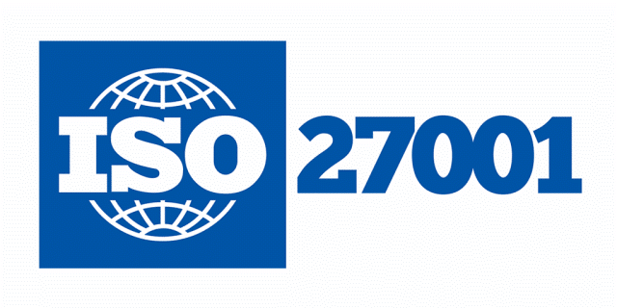
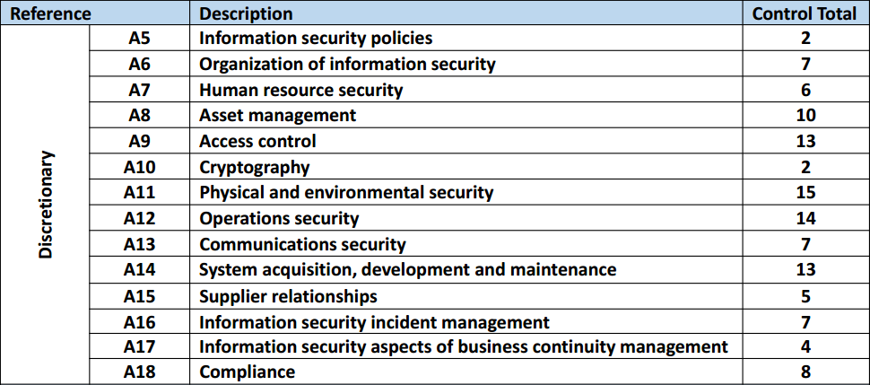
ISO27001:2013 Controls Appendix; Part 9
ISO27001:2013 DISCRETIONARY CONTROLS
TOTAL: 114
https://chapters.theiia.org/bermuda/Events/ChapterDocuments/Information%20Security%20Management%20System%20%28ISMS%29%20Overview.pdf

Slide 3
ISO27001:2013 Controls Appendix; Part 9
A.14 SYSTEM ACQUISITION, DEVELOPMENT, & MAINTENANCE
A.14.1 SECURITY REQMTS OF INFORMATION SYSTEMS
A.14.1.1 | INFORMATION SECURITY REQMTS ANALYSIS & SPECIFICATION
A.14.1.2 | SECURING APPLICATION SERVICES ON PUBLIC NETWORKS
A.14.1.3 | PROTECTING APPLICATION SERVICES TRANSACTIONS

Slide 4
ISO27001:2013 Controls Appendix; Part 9
A.14 SYSTEM ACQUISITION, DEVELOPMENT, & MAINTENANCE
A.14.1.1 | INFORMATION SECURITY REQMTS ANALYSIS & SPECIFICATION | Control: The information security related requirements shall be included in the requirements for new information systems or enhancements to existing information systems.

Slide 5
ISO27001:2013 Controls Appendix; Part 9
A.14 SYSTEM ACQUISITION, DEVELOPMENT, & MAINTENANCE
A.14.1.2 | SECURING APPLICATION SERVICES ON PUBLIC NETWORKS | Control: Information involved in application services passing over public networks shall be protected from fraudulent activity, contract dispute and unauthorized disclosure and modification.

Slide 6
ISO27001:2013 Controls Appendix; Part 9
A.14 SYSTEM ACQUISITION, DEVELOPMENT, & MAINTENANCE
A.14.2 SECURITY IN DEV. & SUPPORT PROCESSES
A.14.2.1 | SECURE DEVELOPMENT POLICY
A.14.2.2 | SYSTEM CHANGE CONTROL PROCEDURES
A.14.2.3 | TECHNICAL REVIEW OF APPLICATIONS AFTER OPERATING PLATFORM CHANGES
A.14.2.4 | RESTRICTIONS ON CHANGES TO SOFTWARE PACKAGES
A.14.2.5 | SECURE SYSTEM ENGINEERING PRINCIPLES

Slide 7
ISO27001:2013 Controls Appendix; Part 9
A.14 SYSTEM ACQUISITION, DEVELOPMENT, & MAINTENANCE
A.14.2 SECURITY IN DEV. & SUPPORT PROCESSES
A.14.2.6 | SECURE DEVELOPMENT ENVIRONMENT
A.14.2.7 | OUTSOURCED DEVELOPMENT
A.14.2.8 | SYSTEM SECURITY TESTING
A.14.2.9 | SYSTEM ACCEPTANCE TESTING

Slide 8
ISO27001:2013 Controls Appendix; Part 9
A.14 SYSTEM ACQUISITION, DEVELOPMENT, & MAINTENANCE
A.14.2.3 | TECHNICAL REVIEW OF APPLICATIONS AFTER OPERATING PLATFORM CHANGES | Control: When operating platforms are changed, business critical applications shall be reviewed and tested to ensure there is no adverse impact on organizational operations or security.

Slide 9
ISO27001:2013 Controls Appendix; Part 9
A.14 SYSTEM ACQUISITION, DEVELOPMENT, & MAINTENANCE
A.14.2.4 | RESTRICTIONS ON CHANGES TO SOFTWARE PACKAGES | Control: Modifications to software packages shall be discouraged, limited to necessary changes and all changes shall be strictly controlled.

Slide 10
ISO27001:2013 Controls Appendix; Part 9
A.14 SYSTEM ACQUISITION, DEVELOPMENT, & MAINTENANCE
A.14.2.5 | SECURE SYSTEM ENGINEERING PRINCIPLES | Control: Principles for engineering secure systems shall be established, documented, maintained and applied to any information system implementation efforts.

Slide 11
ISO27001:2013 Controls Appendix; Part 9
A.14 SYSTEM ACQUISITION, DEVELOPMENT, & MAINTENANCE
A.14.2.8 | SYSTEM SECURITY TESTING | Control: Testing of security functionality shall be carried out during development.

Slide 12
ISO27001:2013 Controls Appendix; Part 9
A.14 SYSTEM ACQUISITION, DEVELOPMENT, & MAINTENANCE
A.14.3 TEST DATA
A.14.3.1 | PROTECTION OF TEST DATA
A.14.3.1 | PROTECTION OF TEST DATA | Control: Test data shall be selected carefully, protected and controlled.

Slide 13
ISO27001:2013 Controls Appendix; Part 9
Lets look at supplier relationships in the next module…
END

